Slide 1
Chapter 3 – Agile Software Development
Instructor
Dr. Sultan S. Alqahtani
ssalqahtani@imamu.edu.sa
Note: These are a slightly modified version of Ch1 slides available from the author’s site http://www.cs.st-andrews.ac.uk/~ifs/Books/SE9/

Slide 2
Before we start
Software processes
Software process models
General process models

Slide 3
Quiz
Name 3 software development processes (activities):
In the waterfall model, the tasks interleaved (T/F).

Slide 4
Topics covered
Agile methods
The Agile Manifesto
Some Agile Methodologies
XP, Scrum
Agile project management
Scaling agile methods

Slide 5
Rapid software development
Rapid development and delivery is now often the most important requirement for software systems
Businesses operate in a fast –changing requirement and it is practically impossible to produce a set of stable software requirements
Software has to evolve quickly to reflect changing business needs.
Rapid software development
Specification, design and implementation are inter-leaved
System is developed as a series of versions with stakeholders involved in version evaluation
User interfaces are often developed using an IDE and graphical toolset.

Slide 6
Agile methods
Dissatisfaction with the overheads involved in software design methods of the 1980s and 1990s led to the creation of agile methods. These methods:
Focus on the code rather than the design
Are based on an iterative approach to software development
Are intended to deliver working software quickly and evolve this quickly to meet changing requirements.
The aim of agile methods is to reduce overheads in the software process (e.g. by limiting documentation) and to be able to respond quickly to changing requirements without excessive rework.

Slide 7
Agile Manifesto
“We are uncovering better ways of developing software by doing it and helping others do it. Through this work we have come to value:”
Individuals and interactions over processes and tools.
Working software over comprehensive documentation.
Customer collaboration over contract negotiation.
Responding to change over following a plan.

Slide 8

Individuals and interactions over processes and tools.

Slide 9

Working software over comprehensive documentation.

Slide 10

Customer collaboration over contract negotiation

Slide 11
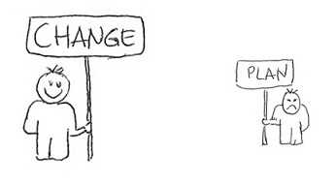
Responding to change over following a plan.

Slide 12
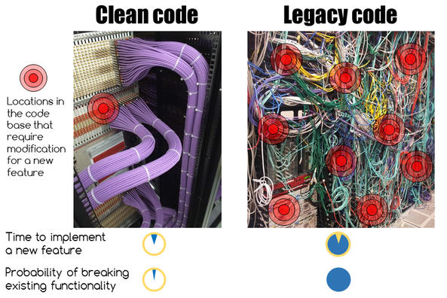

Slide 13
Agile method applicability
Product development where a software company is developing a small or medium-sized product for sale.
Custom system development within an organization, where there is a clear commitment from the customer to become involved in the development process and where there are not a lot of external rules and regulations that affect the software.
Because of their focus on small, tightly-integrated teams, there are problems in scaling agile methods to large systems.

Slide 14
Problems with agile methods
It can be difficult to keep the interest of customers who are involved in the process.
Team members may be unsuited to the intense involvement that characterizes agile methods.
Prioritizing changes can be difficult where there are multiple stakeholders.
Maintaining simplicity requires extra work.
Contracts may be a problem as with other approaches to iterative development.

Slide 15
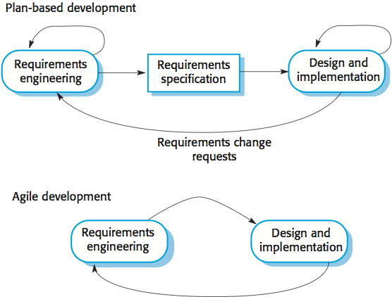
Plan-driven and agile development

Slide 16
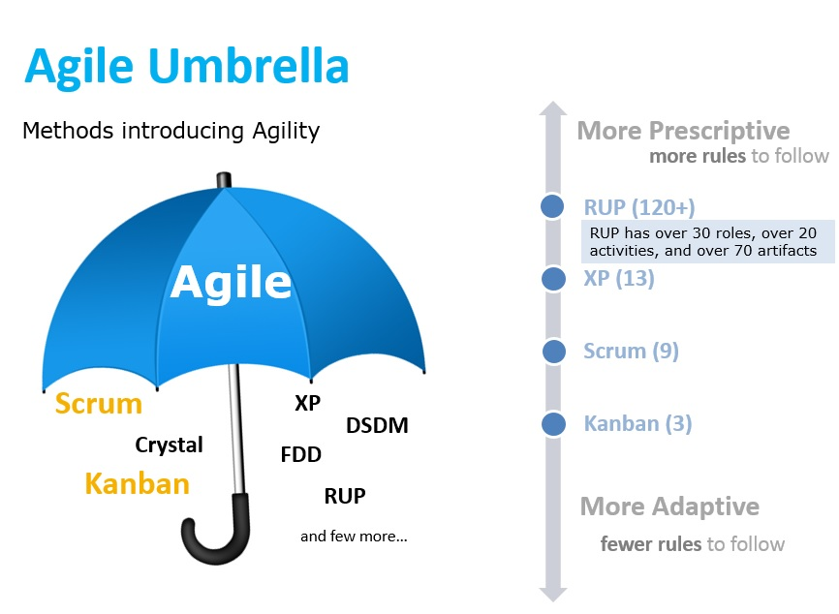
Notes:
Dynamic System Development Method (DSDM)
Feature Driven Development
Rational Unified Process (RUP)

Slide 17
Extreme programming
Perhaps the best-known and most widely used agile method.
Extreme Programming (XP) takes an ‘extreme’ approach to iterative development.
New versions may be built several times per day;
Increments are delivered to customers every 2 weeks;
All tests must be run for every build and the build is only accepted if tests run successfully.

Slide 18
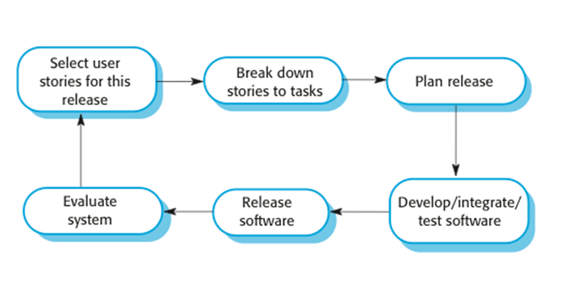
The extreme programming release cycle

Slide 19
Requirements scenarios
In XP, a customer or user is part of the XP team and is responsible for making decisions on requirements.
User requirements are expressed as scenarios or user stories.
These are written on cards and the development team break them down into implementation tasks. These tasks are the basis of schedule and cost estimates.
The customer chooses the stories for inclusion in the next release based on their priorities and the schedule estimates.

Slide 20
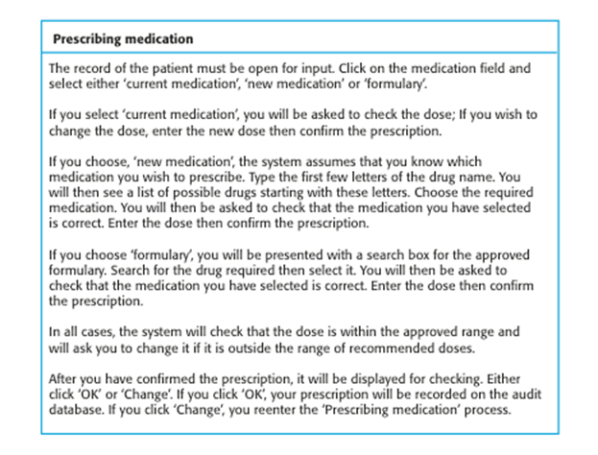
A ‘prescribing medication’ story
Ahmed is a doctor who wishes to prescribe medication for a patient attending a clinic. I he patient record is already displayed on his computer so he clicks on the medication field and can select current. The system displays a list of possible drugs starting with these letters. He chooses the required medication and the system responds by asking him to check that he medication selected is correct. He enters the dose and then confirms he prescription. The system checks that the dose is within the approved range

Slide 21
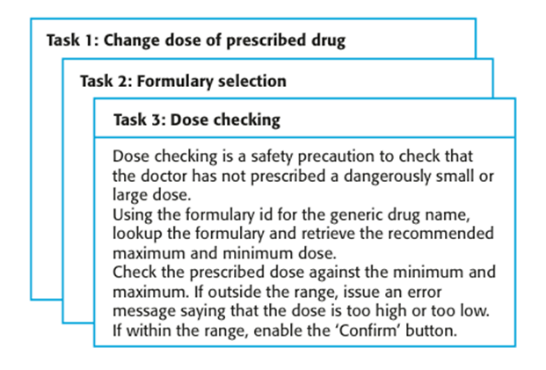
Examples of task cards for prescribing medication

Slide 22
Refactoring
Programming team look for possible software improvements and make these improvements even where there is no immediate need for them.
This improves the understandability of the software and so reduces the need for documentation.
Changes are easier to make because the code is well-structured and clear.
However, some changes requires architecture refactoring and this is much more expensive.

Slide 23
Examples of refactoring
Re-organization of a class hierarchy to remove duplicate code.
Tidying up and renaming attributes and methods to make them easier to understand.
The replacement of inline code with calls to methods that have been included in a program library.

Slide 24
Testing in XP
Testing is central to XP and XP has developed an approach where the program is tested after every change has been made.
XP testing features:
Test-first development.
Incremental test development from scenarios.
User involvement in test development and validation.
Automated test harnesses are used to run all component tests each time that a new release is built.

Slide 25
Test-first development
Writing tests before code clarifies the requirements to be implemented.
Tests are written as programs rather than data so that they can be executed automatically. The test includes a check that it has executed correctly.
Usually relies on a testing framework such as Junit.
All previous and new tests are run automatically when new functionality is added, thus checking that the new functionality has not introduced errors.

Slide 26
Customer involvement
The role of the customer in the testing process is to help develop acceptance tests for the stories that are to be implemented in the next release of the system.
The customer who is part of the team writes tests as development proceeds. All new code is therefore validated to ensure that it is what the customer needs.

Slide 27
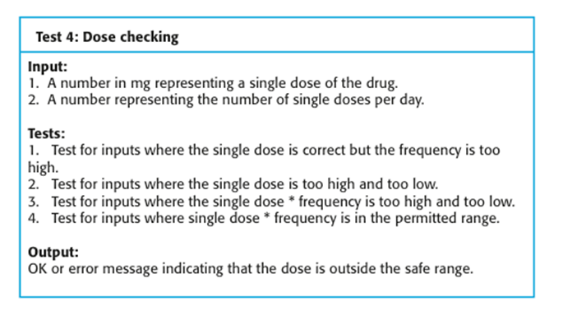
Test case description for dose checking

Slide 28
Test automation
Test automation means that tests are written as executable components before the task is implemented
These testing components should be stand-alone, should simulate the submission of input to be tested and should check that the result meets the output specification. An automated test framework (e.g. Junit) is a system that makes it easy to write executable tests and submit a set of tests for execution.
As testing is automated, there is always a set of tests that can be quickly and easily executed
Whenever any functionality is added to the system, the tests can be run and problems that the new code has introduced can be caught immediately.

Slide 29
XP testing difficulties
Programmers prefer programming to testing and sometimes they take short cuts when writing tests. For example, they may write incomplete tests that do not check for all possible exceptions that may occur.
Some tests can be very difficult to write incrementally. For example, in a complex user interface, it is often difficult to write unit tests for the code that implements the ‘display logic’ and workflow between screens.
It difficult to judge the completeness of a set of tests. Although you may have a lot of system tests, your test set may not provide complete coverage.

Slide 30
Pair programming
In XP, programmers work in pairs, sitting together to develop code.
This helps develop common ownership of code and spreads knowledge across the team.
It serves as an informal review process as each line of code is looked at by more than 1 person.

Slide 31
Advantages of pair programming
It supports the idea of collective ownership and responsibility for the system.
Individuals are not held responsible for problems with the code. Instead, the team has collective responsibility for resolving these problems.
It acts as an informal review process because each line of code is looked at by at least two people.
It helps support refactoring, which is a process of software improvement.
Where pair programming and collective ownership are used, others benefit immediately from the refactoring so they are likely to support the process.

Slide 32
Agile project management
The principal responsibility of software project managers is to manage the project so that the software is delivered on time and within the planned budget for the project.
The standard approach to project management is plan-driven. Managers draw up a plan for the project showing what should be delivered, when it should be delivered and who will work on the development of the project deliverables.
Agile project management requires a different approach, which is adapted to incremental development and the particular strengths of agile methods.

Slide 33
Scrum
The Scrum approach is a general agile method but its focus is on managing iterative development rather than specific agile practices.
There are three phases in Scrum.
The initial phase is an outline planning phase where you establish the general objectives for the project and design the software architecture.
This is followed by a series of sprint cycles, where each cycle develops an increment of the system.
The project closure phase wraps up the project, completes required documentation such as system help frames and user manuals and assesses the lessons learned from the project.

Slide 34
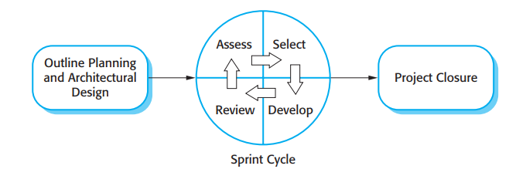
The Scrum process

Slide 35
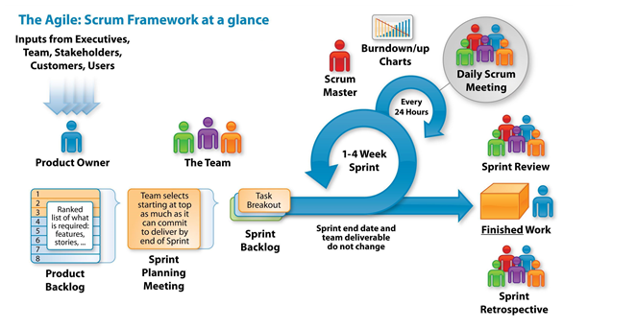

Slide 36
The Sprint cycle
Sprints are fixed length, normally 1–4 weeks. They correspond to the development of a release of the system in XP.
The starting point for planning is the product backlog, which is the list of work to be done on the project.
The selection phase involves all of the project team who work with the customer to select the features and functionality to be developed during the sprint.

Slide 37
The Sprint cycle
Once these are agreed, the team organize themselves to develop the software. During this stage the team is isolated from the customer and the organization, with all communications channelled through the so-called ‘Scrum master’.
The role of the Scrum master is to protect the development team from external distractions.
At the end of the sprint, the work done is reviewed and presented to stakeholders. The next sprint cycle then begins.

Slide 38
Scrum benefits
The product is broken down into a set of manageable and understandable chunks.
Unstable requirements do not hold up progress.
The whole team have visibility of everything and consequently team communication is improved.
Customers see on-time delivery of increments and gain feedback on how the product works.
Trust between customers and developers is established and a positive culture is created in which everyone expects the project to succeed.

Slide 39
Scaling agile methods
Agile methods have proved to be successful for small and medium sized projects that can be developed by a small co-located team.
Scaling up agile methods involves changing these to cope with larger, longer projects where there are multiple development teams, perhaps working in different locations.

Slide 40
Scaling out and scaling up
‘Scaling up’ is concerned with using agile methods for developing large software systems that cannot be developed by a small team.
‘Scaling out’ is concerned with how agile methods can be introduced across a large organization with many years of software development experience.
Example: As projects grow in scope, the agile approach to software development needs to scale up to larger team sizes. Agile also needs to scale out to handle geographically distributed teams as businesses expand into new markets and seek the best talent available globally.

Slide 41
Summary
A particular strength of extreme programming is the development of automated tests before a program feature is created. All tests must successfully execute when an increment is integrated into a system.
The Scrum method is an agile method that provides a project management framework. It is centred round a set of sprints, which are fixed time periods when a system increment is developed.
Scaling agile methods for large systems is difficult. Large systems need up-front design and some documentation.

Slide 42
Thank you !
Questions?

